Slide 1
HAND GESTURE RECOGNITION
Astha Thapar
Malvika Gupta
Nitya Khanna
Parul Sharma

Slide 2
Aim of the Project
This project aims to make a light portable device, using an Inertial Measurement Unit, which can detect hand gestures such as Yaw, Pitch and Roll. This device can then to be used for further application in the field of Hand Gesture Recognition.
The techniques which have been used for gesture recognition have been designed to reduce the amount of hardware required to input data to a machine.

Slide 3
PROJECT BACKGROUND

Slide 4
Gesture Recognition
Gesture is non-verbal communication used either in place of, or in conjunction with, speech
It includes the movement of the hands, face, or other parts of the body
Enables humans to communicate with the machine (HMI) without any mechanical devices.
Gesture Recognition is the ability of a device to identify and respond to the different human gestures
Interpretation of human gestures is done via mathematical algorithms

Slide 5
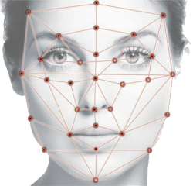
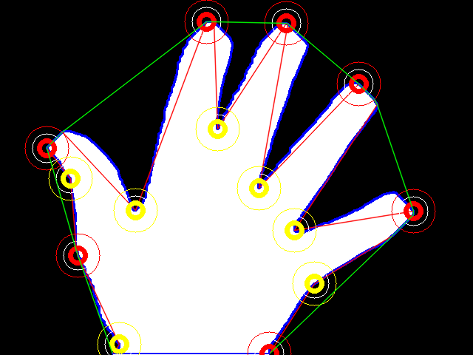

Types of Gesture Recognition
Facial Gesture Recognition
Sign Language Recognition
Hand Gesture Recognition

Slide 6
Hand Gesture Recognition
Allows for the operation of machines and devices using only a series of finger and hand movements.
Highly adaptive interface between machines and their users.
Used in phones, tablets, flight simulator, remote surgery equipment and Smart TV
Eliminates the need for physical contact between the operator and machine

Slide 7
HOW IS GESTURE RECOGNITION PERFORMED?

Slide 8
Inertial Measurement Unit (IMU)
Gesture control is done using IMU
Measures and reports a craft's velocity, orientation, and gravitational forces
A combination of accelerometers and gyroscopes, sometimes also magnetometers

Slide 9
Accelerometer
Measures acceleration forces experienced by a body, in meters per second squared (m/s²) or in G-forces (g).
These forces can be either static or dynamic and can be used to measure orientation, shock, vibration, free fall and have many other applications.
The various types of accelerometers are:
Capacitive
Piezoresistive
Piezoelectric
Accelerometers in mobile phones are used to detect the orientation of the phone.

Slide 10
Gyro Sensor
Devices that sense angular velocity in degrees per second (°/s) or revolutions per second (RPS).
Angular velocity is simply a measurement of speed of rotation. Thus, they measure or maintain rotational motion.
The various types of gyro sensors are:
Ring laser gyros
Fiber-optic gyros
Fluid gyros
Vibration gyros
Adds an additional dimension to the information supplied by the accelerometer by tracking rotation or twist. An accelerometer measures linear acceleration of movement, while a gyro on the other hand measures the angular rotational velocity.

Slide 11
METHODOLOGY

Slide 12
Principle of Accelerometer
The accelerometer measures the gravitational acceleration (g) in three dimensions. To translate the analog readings:
Conversion to volts:
accVol = (accAdc * VRef) / 1023
Shift from zero voltage level
accDel = accVol - accZero
Force values to g
accVal = accDel/sensitivity
where, accAdc is the analog reading,
Vref is the reference voltage,
accZero is the value when it is horizontal.
Sensitivity is the sensitivity found in the datasheet, but translated into quids.

Slide 13
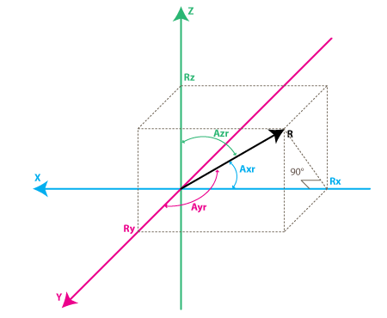
How to calculate acceleration along x, y and z axis
Let Rx, Ry and Rz be the respective accVal for x, y and z axis.
R = SQRT( Rx² + Ry² + Rz²)
The angles with respect to x, y and z axis are:
Axr = arccos(Rx/R)
Ayr = arccos(Ry/R)
Azr = arccos(Rz/R)

Slide 14
Principle of Gyro Sensor
Gyros sensors are devices that sense angular velocity in degrees per second (⁰/s). To translate analog readings convert input values to rate (deg/s) (for 2-axes gyro):
RateAxz = (AdcGyroXZ * Vref / 1023 - VzeroRate) / Sensitivity
RateAyz = (AdcGyroYZ * Vref / 1023 - VzeroRate) / Sensitivity
where, Vref - is the ADC reference voltage
VzeroRate is the zero-rate voltage, the voltage that the gyroscope outputs when it is not subject to any rotation
To translate this into degrees use Millis() command in Arduino , to know the exact time since last loop. By using that, one can calculate the time difference and thereby calculate the angle of the gyro.

Slide 15
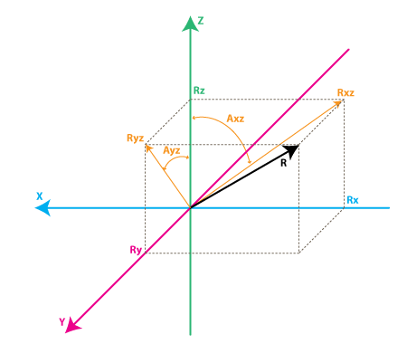
Rxz - is the projection of the inertial force vector R on the XZ plane
Ryz - is the projection of the inertial force vector R on the YZ plane
Axz - is the angle between the Rxz (projection of R on XZ plane) and Z axis
Ayz - is the angle between the Ryz (projection of R on YZ plane) and Z axis
Axz = Axz + RateAxz*dtime/1000
Ayz = Ayz + RateAyz*dtime/1000

Slide 16
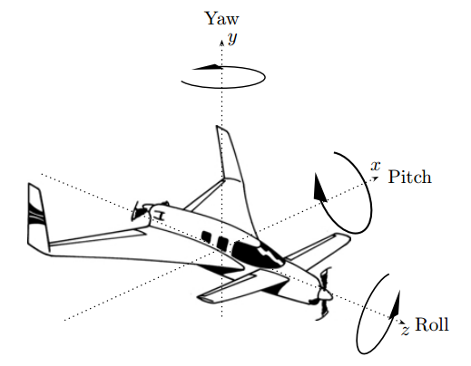
Principle Of 3D Rotation
The Euler angles are three angles that describe the orientation of a rigid body. They are typically denoted as α, β, γ
Euler angles represent a sequence of three elemental rotations, i.e. rotations about the axes of a coordinate system. Any orientation can be achieved by composing three elemental rotations.
An example of Euler angles is Yaw, pitch, and roll which specify an orientation in terms of three successive rotations around the x-, y-, and z-axes.
If the axes move with the object: Yaw Pitch Roll (YPR)
If the axes do not move with the object: Roll, Pitch, Yaw (RPY)

Slide 17
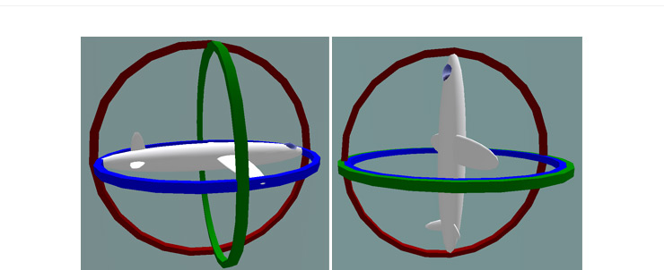
Gimbal Lock- Limitation of Euler Angles
Gimbal lock is the loss of one degree of freedom at particular angle settings (to be precise, at pitch equal to ±90◦)
Occurs when the axes of two of the three gimbals are driven into a parallel configuration, "locking" the system into rotation in a degenerate two-dimensional space.
Due to the parallel orientation of two of the gimbals axes there is no gimbal available to accommodate rotation along one axis.

Slide 18
PROJECT IMPLEMENTATION

Slide 19
Components used
Arduino UNO
The Uno is a microcontroller board based on the ATmega328P microcontroller
. It consists of:
14 digital input/output pins (of which 6 can be used as PWM outputs)
6 analog inputs
16 MHz quartz crystal,
USB connection to connect it with a computer
Power jack to connect it to an AC-to-DC adapter or battery
Reset button
Arduino boards are Programming of microcontroller done through the Arduino Integrated Development Environment - or Arduino Software (IDE)

Slide 20
MPU 6050
6 DOF (Degrees of Freedom) or a six axis IMU (Inertial Measurement unit) sensor,
Gives six values as output; three values from the accelerometer and three from the gyroscope.
Contains a MEMS accelerometer and a MEMS gyro in a single chip.
Uses the I2C-bus to interface with the Arduino.
The sensor has a "Digital Motion Processor" (DMP), which computes values in Quaternions to ensures that Gimbal Lock doesn’t occur in the system
M2M and F2F Wires

Slide 21
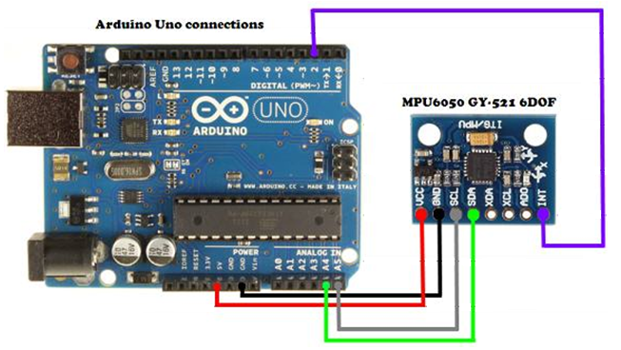
I2C Interfacing Arduino With MPU 6050

Slide 22
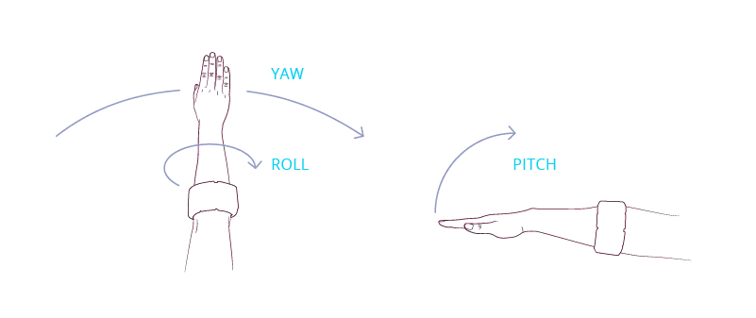
Hand Gestures Recognised:
Yaw
Pitch
Roll

Slide 23
OBSERVATIONS

Slide 24
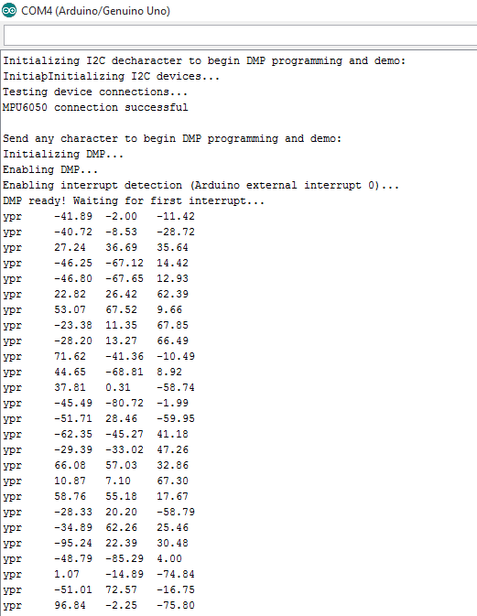


Slide 25
REAL TIME DEMONSTRATION OF THE PROJECT

